Slide 1

DealBazaar with Payline

Slide 2

Introduction to DealBazaar
E-commerce Platform
DealBazaar is an innovative e-commerce platform providing a wide range of products and services to the global market.
User-friendly Interface
The platform offers a seamless user experience with easy navigation and secure transactions.
Diverse Product Range
DealBazaar features a diverse selection of products, ensuring a one-stop shopping experience for customers.

Slide 3
Payline: The Blockchain Payment Gateway
Efficient Processing
Transparent Transactions
Decentralized System
Payline offers fast and efficient payment processing, simplifying transactions for both merchants and customers.
Payline ensures transparency in financial transactions, utilizing blockchain technology for secure and immutable records.
The payment gateway operates on a decentralized network, reducing the risk of fraud and enhancing reliability.

Slide 4

Integration of Payline with DealBazaar
Advantages of Integration
The integration of Payline with DealBazaar streamlines payment processing, providing a seamless and secure checkout process.
Enhanced Customer Experience
Customers benefit from a frictionless payment experience, leading to increased satisfaction and loyalty.
Simplified Process
The integration process is straightforward, offering merchants easy access to the benefits of blockchain-based payments.

Slide 5

Benefits of Payline for DealBazaar
Advantages for DealBazaar
Customer Experience
DealBazaar achieves enhanced security and reduced transaction costs through the utilization of Payline's blockchain payment technology.
Customers enjoy secure and efficient transactions, fostering trust and confidence in DealBazaar's payment processes.
Enhanced Security Measures
The use of blockchain technology provides robust security measures, safeguarding both merchants and customers from potential threats.

Slide 6
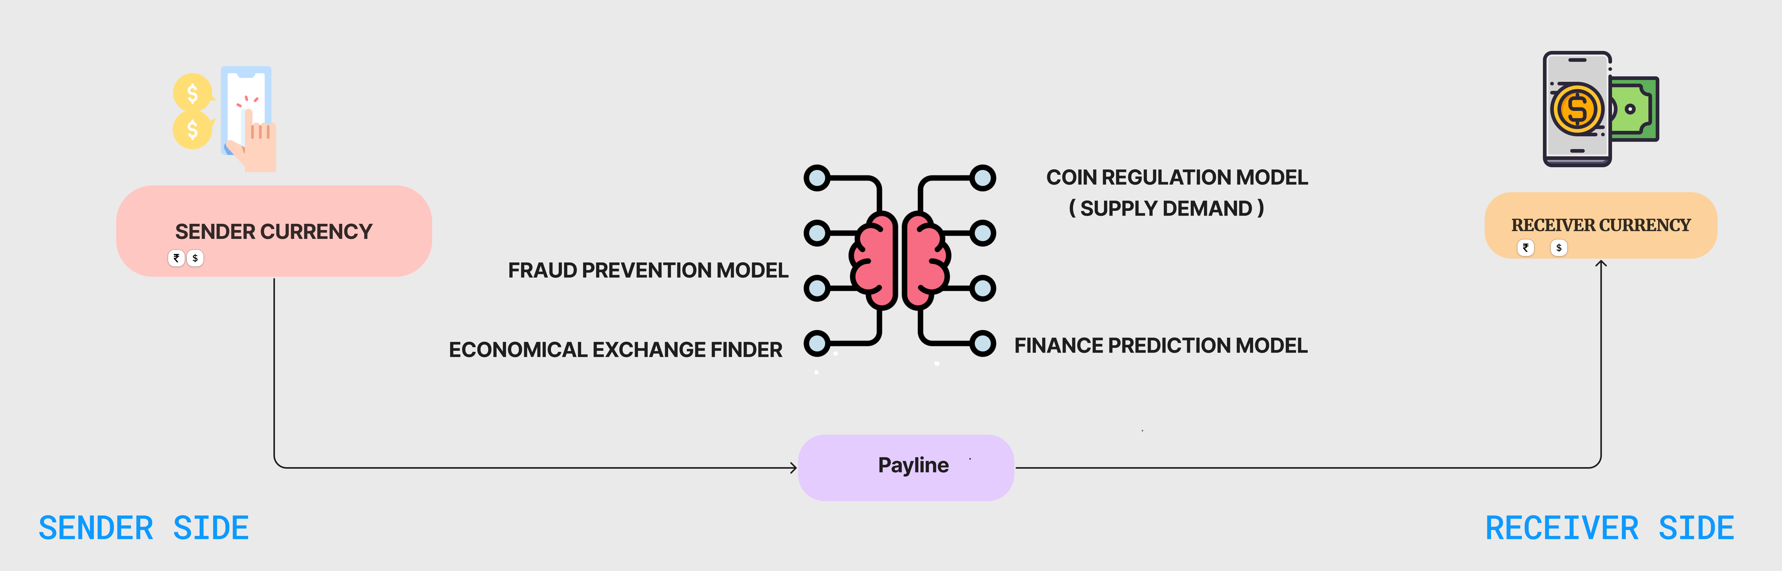

Slide 7
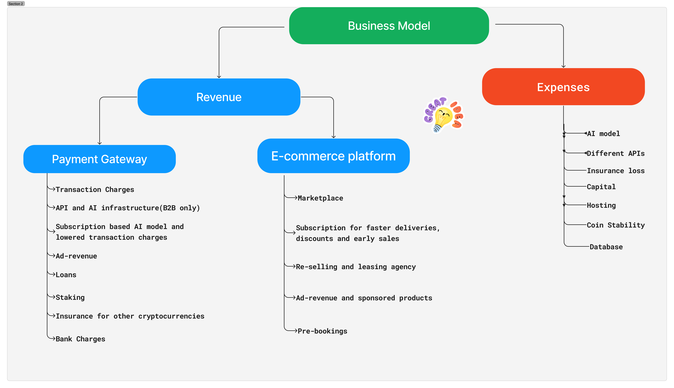

Slide 8
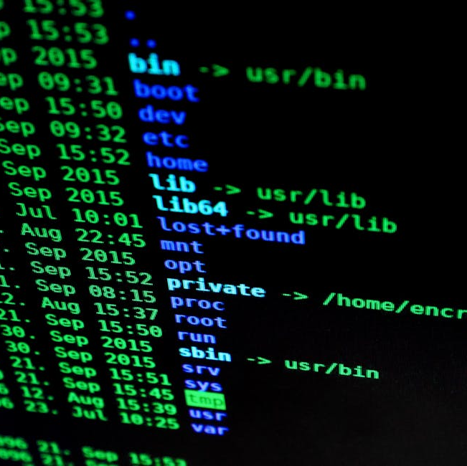
Improved Security with AI integration
AI-Powered Security Measures
DealBazaar incorporates AI-driven security protocols to proactively identify and respond to potential cybersecurity threats.
Data Protection
The integration of AI enhances data protection, continuously monitoring for suspicious activities and mitigating risks.
Fraud Prevention
The combination of blockchain-based payments and AI-driven security establishes a comprehensive approach to safeguarding transactions and thereby minimizing risks of frauds.

